Slide 1

Presented by: Olusesi Olabode E. Last Updated: 02/09/2022

Slide 2

INTRODUCTION
The goal of this project is to provide data-driven insights on ways to improve donations received by Education for All Charity which would be measurable if we can:
Increase the number of donors in the database.
Increase the donation frequency of these donors.
Increase the value of donations received.

Slide 3
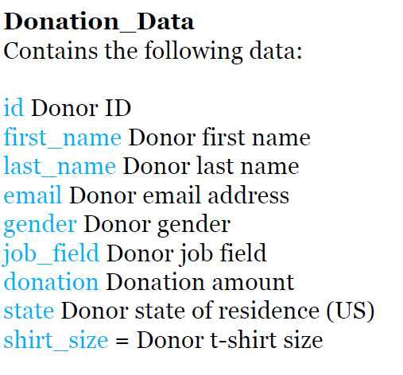
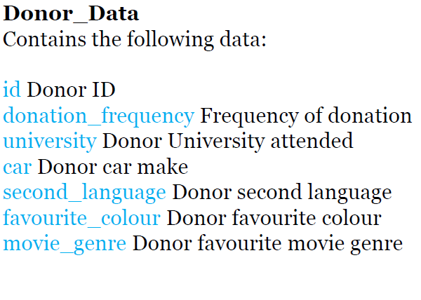
TABLES

Slide 4
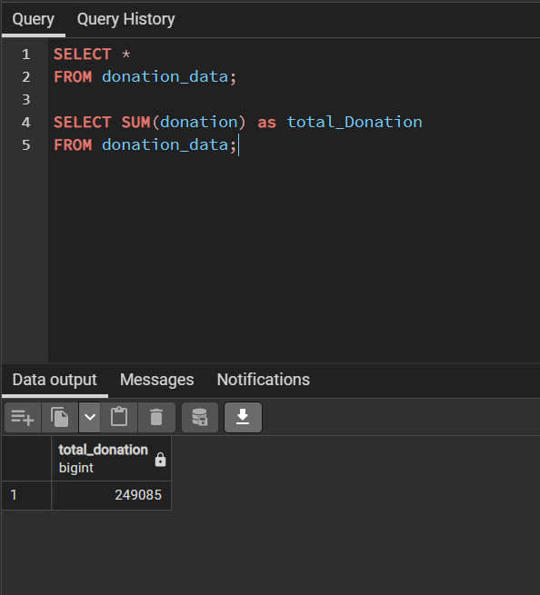
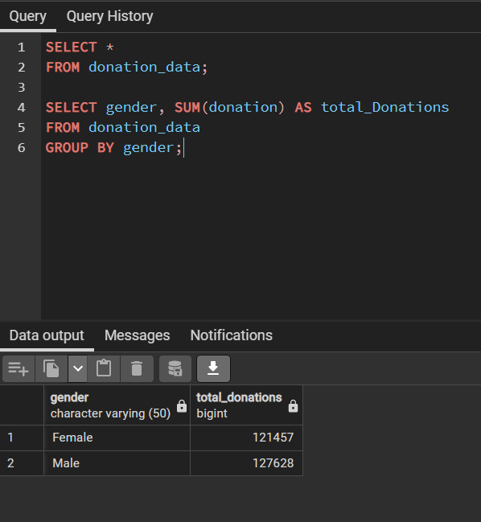
ANALYSIS
a. How much is the total donation?
b. What is the total donation by gender?

Slide 5
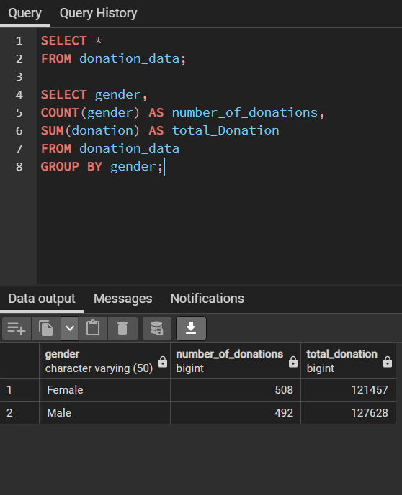
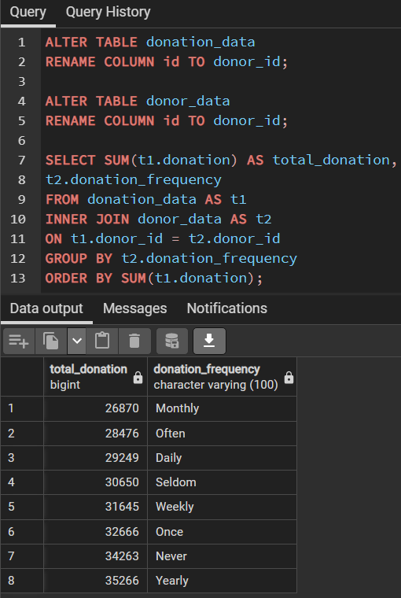
ANALYSIS
c. Show the total donation and number of donations by gender
d. Total donation made by frequency of donation

Slide 6
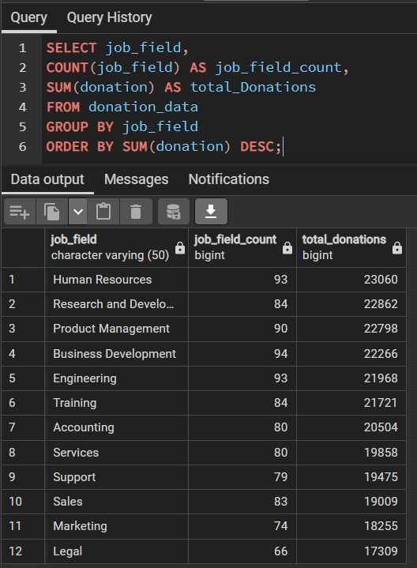
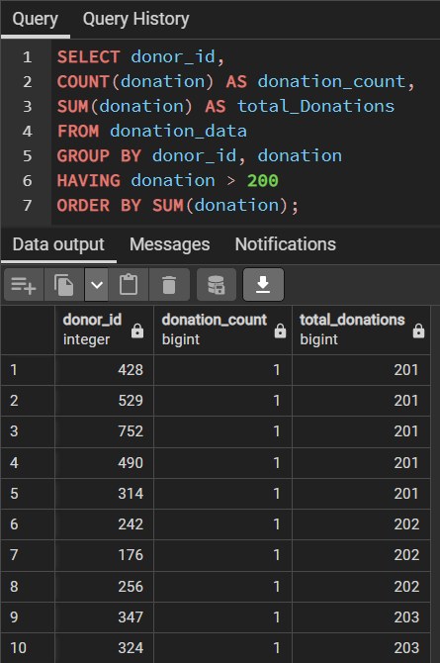
ANALYSIS
e. Total donation and number of donations by job field
f. Total donation and number of donations above $200

Slide 7
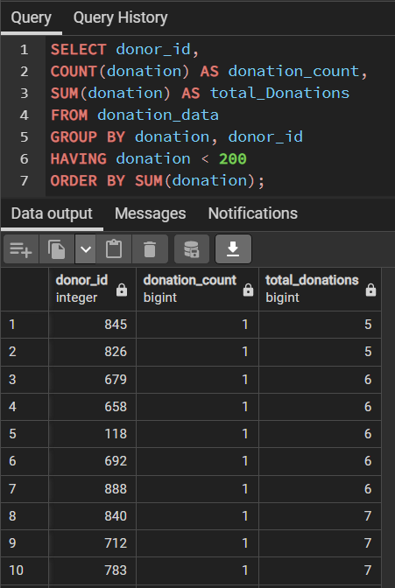
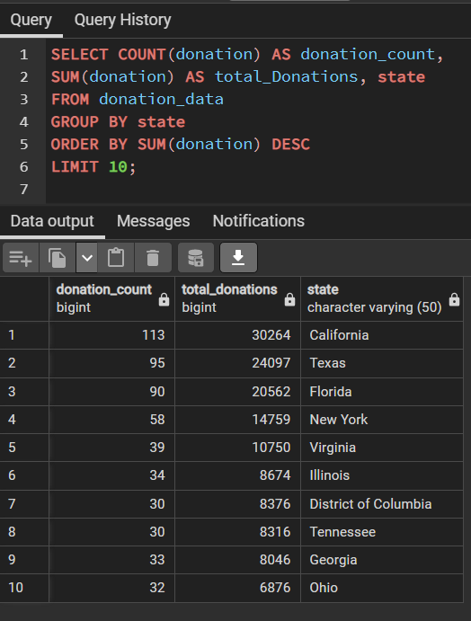
ANALYSIS
g. Total donations and number of donations below $200
h. Which top 10 states contributes the highest donation?

Slide 8
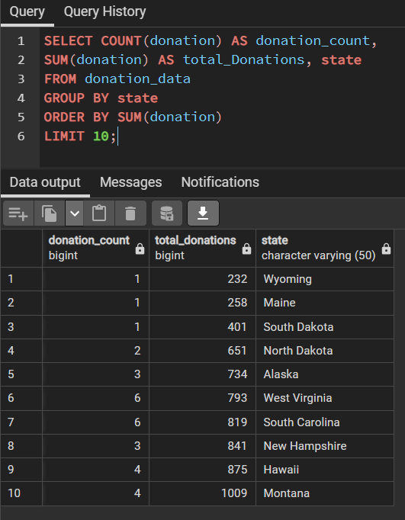
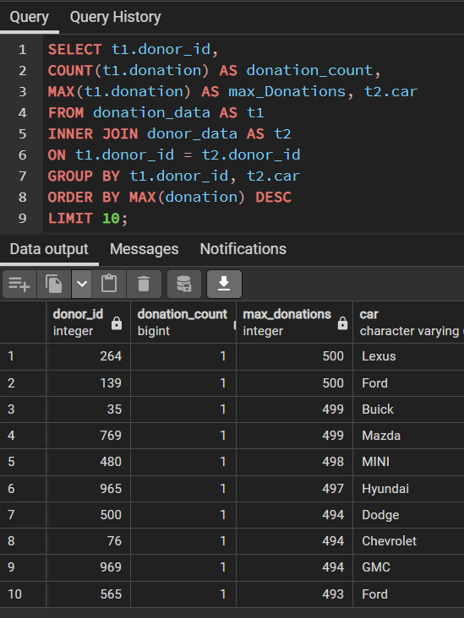
ANALYSIS
i. Which top 10 states contributes the least donation?
j. What are the top 10 cars driven by the highest donors?

Slide 9
RECOMMENDATIONS
Based on the insights generated from the data analysis done in preceding slides, I would recommend the following to Education for all Charity:
More donors donated over $200 and more charity ads should be targeted at those in this category in order to increase the total value of donations received.
Although more women than men donated, total donations from men still exceeds that of the women. Hence, female donors should be encouraged to increase their minimum donations.
Periodic emails highlighting projects being executed by Education for all Charity should be sent to the yearly and first time (Never) donors as these groups gave the highest donations.

Slide 10
THANK YOU

